Slide 1
Course - DT228-2
Module (Subject) -
Human Computer Interaction
Semester 2, Week 8
INTERACTION STYLES:
INPUT and OUTPUT

Slide 2
Overview of Lecture
Input Devices
Selecting Input Devices
Interactive Devices
Keystroke Level Model (Measuring Input)
Output Devices
Output Device Types
Selecting Output Devices

Slide 3
Selecting Input and Output Devices
When selecting, the designer needs to consider:
The User’s physiological capabilities
The User’s expertise
Appropriateness for tasks
Work and environment

Slide 4
Selecting Input Devices
Match the user’s physiological capabilities
E.G. A keyboard for older users with arthritis may be a problem
Match the user’s expertise
E.G. A keyboard for older users, or inexperienced users, may be a problem
… continued

Slide 5
Selecting Input Devices (2)
The input device;
should be appropriate for the tasks performed
E.G. for drawing, you need a device that allows continuous movement
should be suitable for the intended work and environment
E.G. speech input is not suitable for noisy conditions

Slide 6
Selecting Output Devices
Match the user’s physiological capabilities
E.G. Screens for visual output may be a problem for users with visual disabilities
Match the user’s expertise
E.G. Touch screens for users with physical disabilities may be a problem
… continued

Slide 7
Selecting output Devices (2)
The output device;
should be appropriate for the tasks performed
E.G. For graphics, you may need a monitor with high definition, or a printer with many dots-per-inch (DPI)
should be suitable for the intended work and environment
E.G. Sound output is not suitable for noisy conditions

Slide 8
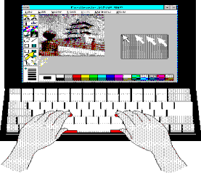
Interaction Device Introduction
You cannot separate the computer system interface function from input-output interaction devices.

Slide 9
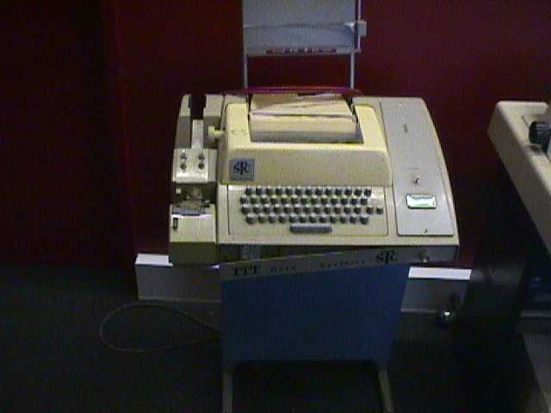
Interaction Device Introduction (2)
ASR33 teletype: An early input/output device

Slide 10
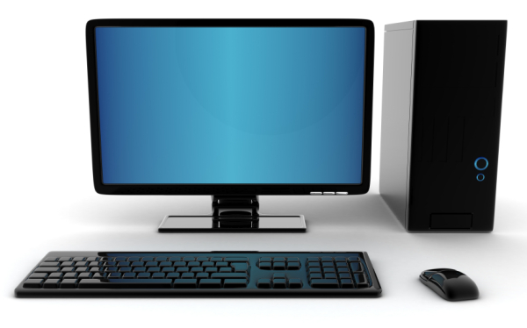
The current norm for desktop systems
Input via keyboard and mouse
Output via text, pictures, movement, sound

Slide 11
Interaction Device Introduction (3)
Interaction
Devices
Input
Devices
Output
Devices

Slide 12
Input Devices
An input device is a device that, together with appropriate software, transforms information from the user into data that a computer application can process.
Input devices can be categorised into
Text entry devices
Positioning and pointing devices
Devices that input pictures
Devices that input sound

Slide 13
Text-Entry Devices
Keyboards
Other text-entry devices

Slide 14
keyboards
Keyboards Types:
QWERTY
Alphabetic
Chord
Dvorak
Braille
Mobile Phone Keyboard
Text-Entry Devices

Slide 15
QWERTY keyboards
Most common keyboard
Named from topmost left six letters
Based on typewriter key layout design – designed to prevent jamming of the keys
Not optimal for typing – frequently used letters placed far apart thereby increasing finger travel distances
Cost of replacement perpetuates use
Text-Entry Devices

Slide 16
Alphabetic keyboards
Keys arranged in alphabetic order
Not faster for trained typists
Not faster for beginners either
No inherent advantage
Sometimes used in personal organisers
Text-Entry Devices

Slide 17
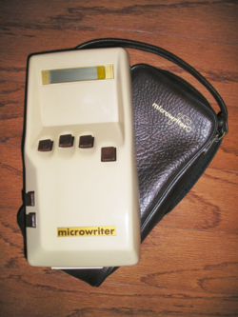
ChoRd keyboards
Only a few keys - four or five
Letters typed as a combination of key-presses
Compact size - ideal for portable applications
One handed use
Short learning time
Fast
But fatigue after extended use
Sample use – transcript recording in court
Text-Entry Devices

Slide 18
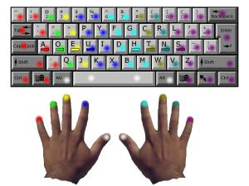
Dvorak keyboards
Common letters are under dominant fingers
It is biased towards the right hand
Common combinations of letters alternate between hands
10-15% improvement in speed and reduction in fatigue
But – the large social base of QWERTY typists produce market pressures not to change
Text-Entry Devices

Slide 19
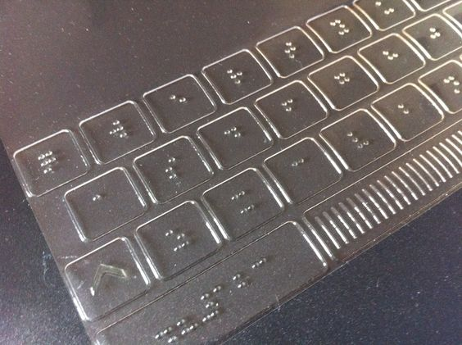
Braille keyboards
Keyboard especially adapted to blind or visually impaired users
Keys are embossed to enable identification of keys
Frequently used with “voice output” systems
Text-Entry Devices

Slide 20
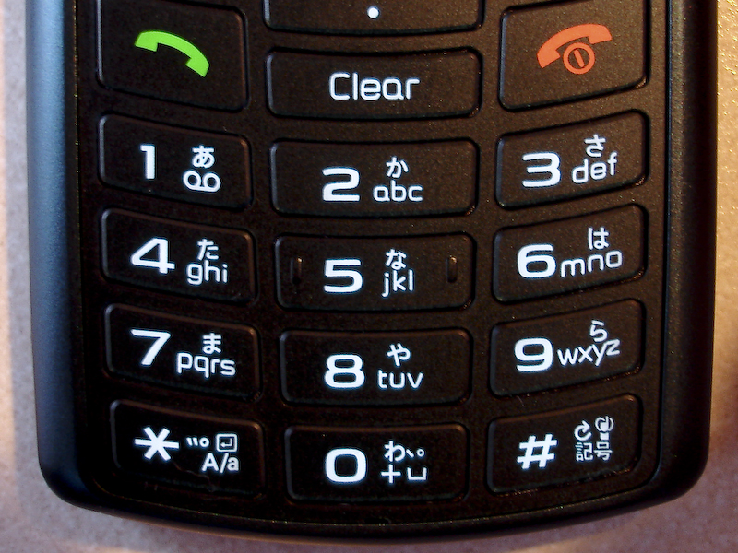
Mobile Phone keyboards
Multi-tap mappings
Multiple presses per letter
Predictive entry
One press per letter, dictionary lookup
E.G. ‘T9’
Text-Entry Devices

Slide 21
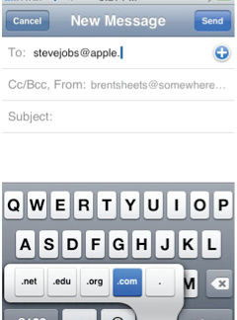
Mobile Phone keyboards (2)
Soft keyboards
Benefits?
Drawbacks?
Text-Entry Devices

Slide 22
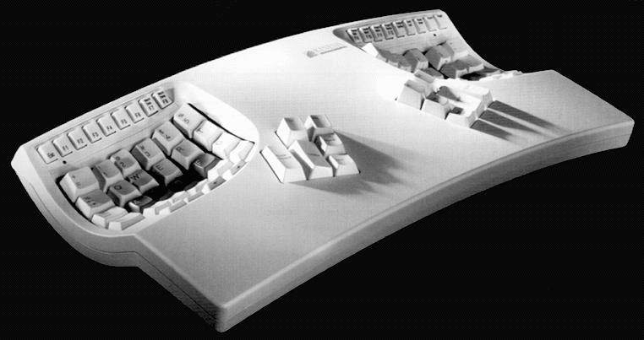
ergonomic keyboard Design

Slide 23
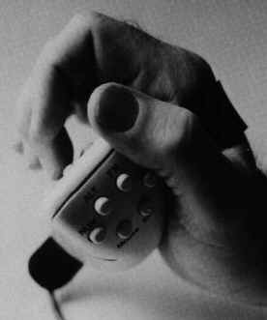
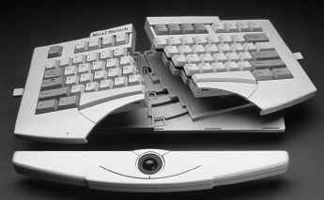
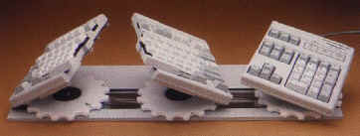
ergonomic keyboards

Slide 24
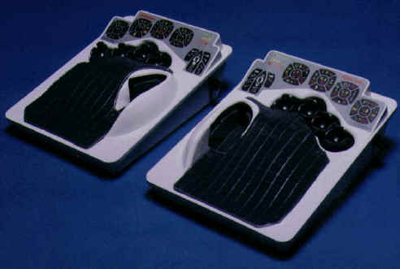
ergonomic keyboards (2)

Slide 25
Text Entry Devices
Handwriting Recognition
Handwritten text is input to the computer
Athis is an attractive option as a text entry method because handwriting is a common familiar activity
Text-Entry Devices

Slide 26
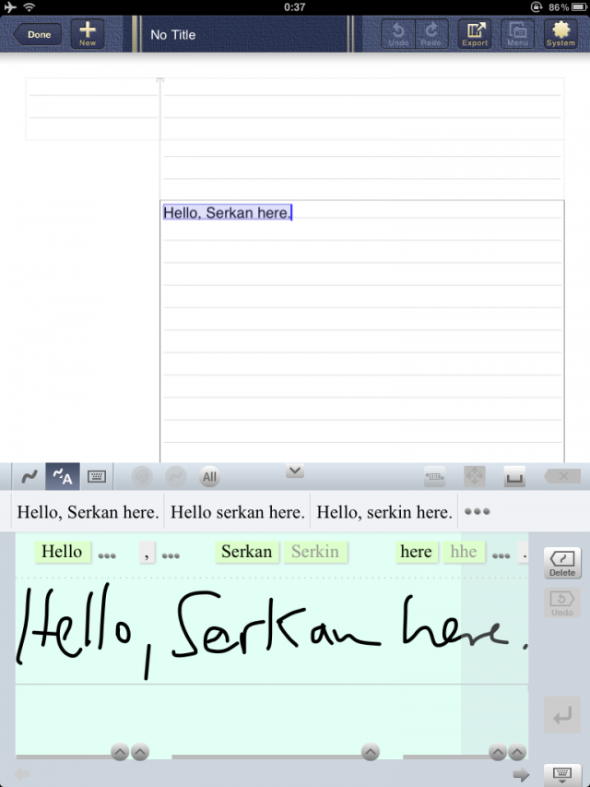
Text Entry Devices (2)
iPhone/iPad App by 7notes for handwriting recognition
Text-Entry Devices

Slide 27
Speech Recognition
Speech recognition technology replaces a computer keyboard with a microphone and software to change the spoken word into typed characters.
Speech is a natural form of communication.
Disadvantages:
Limited by recognition error rate of speech recognition systems
Variety of accents and intonations increase error rate
External noise interfering
Text-Entry Devices

Slide 28
Positioning and pointing devices
Pointing devices are generally fast and easy to use, but require hand-eye coordination.
Pointing devices can be divided into:
Direct versus Indirect Control devices
Devices for disabled users
Positioning & Pointing Devices

Slide 29
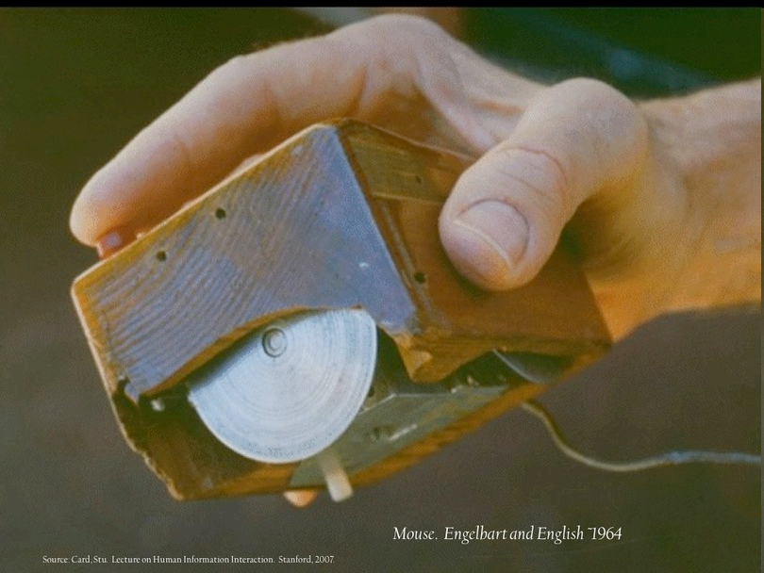
Positioning and pointing devices (2)
Mouse prototype
Positioning & Pointing Devices

Slide 30
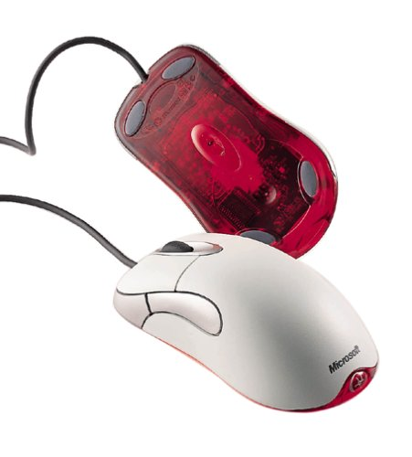
Positioning and pointing devices (2)
Indirect Pointing Devices – Mouse
Requires physical space for movement
Provides relative motion
Can be difficult for novice users (indirect mapping)
Two characteristics: planar movement, and buttons
Positioning & Pointing Devices

Slide 31
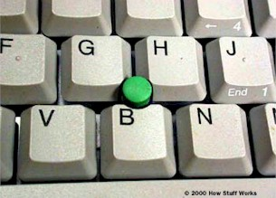
Positioning and pointing devices (3)
Indirect Pointing Devices – Trackball
Weighted ball is rotated inside a static housing
Compact, so good for limited space situations – E.G. laptops
Difficult for long movements
Requires separate buttons for ‘Select’
Positioning & Pointing Devices

Slide 32
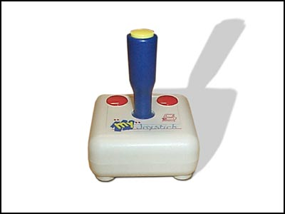
Positioning and pointing devices (4)
Indirect Pointing Devices – Joystick
Usually used for tasks incorporating direction and speed rather than location
Compact - requires very little space
Absolute (movement) and isometric (direction and velocity)
Inexpensive and robust
Often found in computer games
Positioning & Pointing Devices

Slide 33
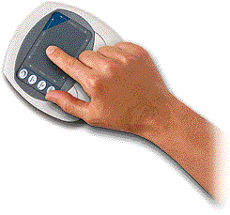
Positioning and pointing devices (5)
Indirect Pointing Devices – Touchpad
Typically used in portable computers to replace mouse
Advantage: requires minimal space (typically 2-3 inches in size
Disadvange: can be difficult and inaccurate to use
Positioning & Pointing Devices

Slide 34
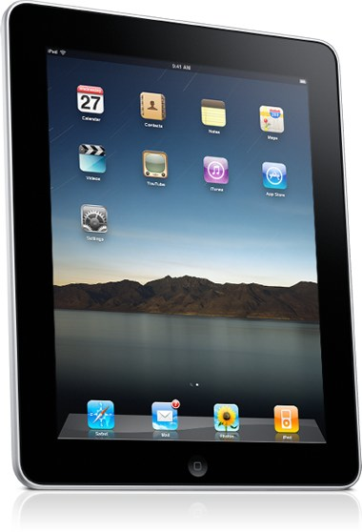
Positioning and pointing devices (6)
Direct Control Pointing Devices – Touch Sensitive Screens
Allows direct control through touching on the screen (using a finger)
The users touch the surface
Positioning & Pointing Devices

Slide 35
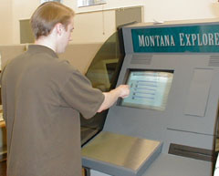
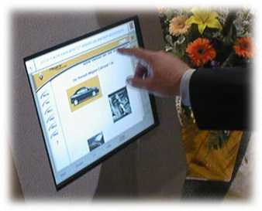
pointing devices
Touchscreens
Positioning & Pointing Devices

Slide 36
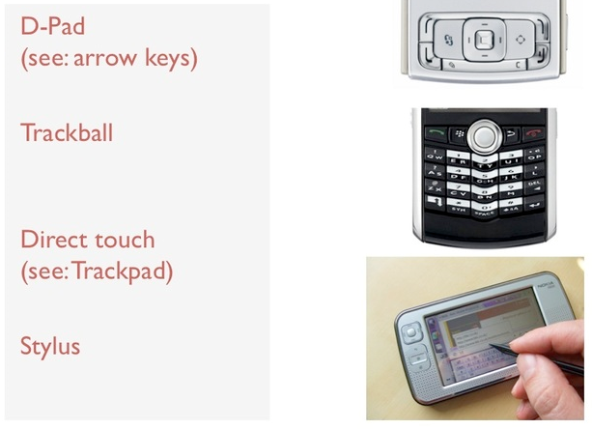
Mobile pointing devices
D-Pad (arrow keys)
Trackball
Direct touch (trackpad)
Stylus
Positioning & Pointing Devices

Slide 37
Positioning and pointing devices (7)
Direct Control Pointing Devices – Light Pens
Enabling users to point to a spot on a screen and to perform a select, position, or other task
Disadvantages:
users' hands obscures part of the screen,
users have to remove their hands from the keyboard,
users have to pick up the lightpen
Positioning & Pointing Devices

Slide 38
Positioning and pointing devices (8)
Devices for Less Abled Users – EyeGaze Device
An eyegaze unit is worn on a headband on the user’s head – screen cursor is driven by the users eye movements
Advantages: good for disabled users with motor impairments or any environment where user is limited in movement
+ Fast
+ Accurate
Disadvantages
- Expensive
- Good for selection, but not for continuous movement of cursor
Positioning & Pointing Devices

Slide 39
Positioning and pointing devices (9)
Devices for Less Abled Users – Eye Typer Device
Developed for users with severe motor impairment
The user “types” by scanning the keyboard and fixing momentarily on each character that is wanted
The characters are displayed on a panel in qwerty keyboard layout. Each character has a light embedded in it. The display has a camera that can detect which character the user is looking at.
Positioning & Pointing Devices

Slide 40
Positioning and pointing devices (10)
Devices for Less Abled Users – Head Movement Tracker
Developed for users with severe motor impairment
The user wears a lightweight headset. The “keyboard” is a display on the screen. The system detects slight movements of the user’s head to move cursor. To operate a key, user moves cursor to the key and blows on a blow switch.
Positioning & Pointing Devices

Slide 41
Other device Types
Picture Entry Devices
Scanners
Video cameras
MPEG camera
Sound Entry Devices
Microphone
Positioning & Pointing Devices

Slide 42
Input Measuring Example: K.L.M.
Keystroke Level Model (KLM) by Card, Moran and Newell (1980)
Purpose
Approximate prediction of time to perform tasks
Allows comparison between alternative design options
Applicable in principle to any interactive system
Assumptions
That these are routine tasks
That the user is expert (Error-free performance)
Assumes knowledge of task/sub-tasks, method used for task and some information about the system.
Input Devices
Notes:
Actual, numerical predictions for standard tasks users have to carry out when interaction with a (actual or proposed) system.
Card, Moran and Newell’s 1983 book The Psychology of Human-Computer Interaction was a landmark in the development of HCI as a subject. In it they argued that system developers needed evaluation methods which would enable them to make design decisions. They suggested that decision-making typically did not demand highly precise estimates of performance, but it was important that the estimates could be made quickly. In their book they describe a set of models (the GOMS models - see later for explanation of the term) which make approximate predictions of task performance time and which would meet this requirement. The first one they described (Card et al 1980) - and the simplest to understand - was the Keystroke Level Model (KLM).
Card et al’s method relies under a number of assumptions. Firstly, performance can only be predicted for routine tasks (like text editing); more complex tasks - say, designing a car, or controlling a nuclear power station - would be too complex to model using their technique. Secondly, they can only model the behaviour of an expert user who does not make errors. This assumption is necessary because new users are highly variable in their behaviour and it is difficult to predict what they will do; Card et al defended it with the argument that most systems will ultimately be operated by expert users after they have been exposed to the system for a while. Is this a sound argument?
Finally, the technique requires some detailed information about the system before it can be applied.

Slide 43
Content of the Keystroke Level Model
A description of the task
A simple model of the user
A simple model of the computer
Tasks are executed by a sequence of operators - physical actions of the user and computer
(Time) T_{execute} = TK + TP + TH + TD + TM + TR
where K = keystroking; P = pointing; H = homing; D = drawing; M = mental operator; R = system response operator

Slide 44
K.L.M. Example from Card et al (1980)
Method for Task :
-Jump to next line MK[LINEFEED]
-Call substitute command MK[S]
-Specify new 5-digit word 5K[word]
-Terminate argument MK[RETURN]
-Specify old 5-digit word 5K[word]
-Terminate argument MK[RETURN]
-Terminate command K[RETURN]
T_{execute} = 4tM + 15tK = 8.4 sec.
tK = 0.2sec
tM = 1.35sec
Keyboard-based editor
Mouse-based editor
Method for task :
Reach for mouse H[mouse)
Point to word P[word]
Select word K[YELLOW]
Home on keyboard H[keyboard]
Call replace command MK[R]
Type new 5-digit word 5K[word]
Terminate type-in MK[ESC]
T_{execute} = 2tM + 8tK + 2tH + tP = 6.2s
tK = 0.2sec
tM = 1.35sec
tH = .9sec
tP = .4sec
Conclusion: mouse-based
interaction is faster
44
Notes:
The 1980 paper by Card et al illustrates the use of the KLM in the evaluation of two alternative user interfaces for text editing. One was a traditional keyboard based editor (POET), requiring the specification of a string to be replaced followed by entry of the corrected string; and the other exploited the (then novel) mouse for selecting a string to be corrected (a display editor - DISPED).
The tasks for each of the two editors is specified as a sequence of operators and the operators are replaced with times based upon a user model specified in the paper (for example, keystrokes are assumed to take 0.2sec.). Summing the times for implementing the operators shows that the task can be performed more quickly using the mouse-based display editor than the keyboard-based system. Assuming speed is the most relevant aspect of performance, the evaluation suggests that the display editor is preferable.
[This description has simplified some aspects of the KLM; you could look at Card et al’s paper - it’s quite short - for the way they addressed some of the complexities.]

Slide 45
Interaction Device Introduction (4)
Interaction
Devices
Input
Devices
Output
Devices

Slide 46
Output devices
Output devices are those devices that convert the computer’s response into a form perceptible by a human, known as output.
Output devices can be categorised into :
Visual output devices
Sonic (Sound) output devices

Slide 47
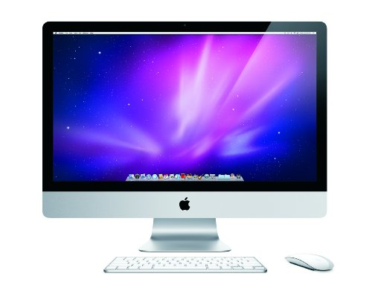

Visual Output devices
Visual output - using a screen is by far the most common form of output today.
Visual Output Devices

Slide 48
Visual Output devices (2)
Raster-scan cathode-ray tube (CRT)
Liquid-crystal displays (LCDs)
Plasma displays (… Are they ALL gone?)
Projectors
Printers
Visual Output Devices

Slide 49
Visual Output devices - CRTs
Pixels refreshed by ‘Raster’
Visual Output Devices

Slide 50
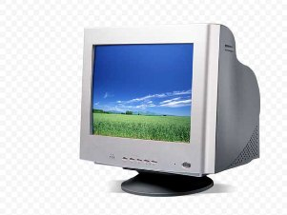
Visual Output devices – CRTs (2)
The oldest screen technology is the Cathode Ray Tube (CRT) screen
+ Cheap
+ Can support rapid animation
+ High colour capability
- Bulky device
- Has associated health risks – radiation concerns. Flicker, poor legibility and low contrast can cause eyestrain and fatigue
Visual Output Devices

Slide 51
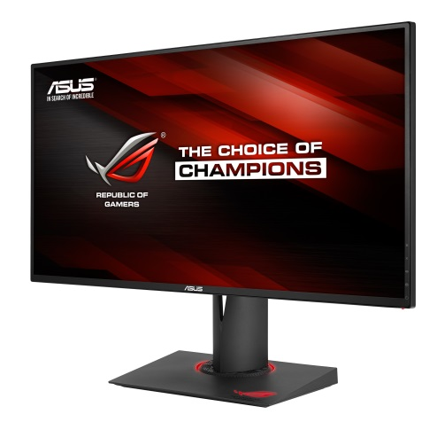
Visual Output devices - LCDs
Light, flat plastic screens
+ Smaller (than C.R.T.s)
+ lighter (than CRTs)
+ use less power (than CRTs)
+ no radiation problems
+ Less tiring than C.R.T. displays, and reduced eye-strain, due to reflected nature of light rather than emitted
Visual Output Devices

Slide 52
Visual Output devices - Plasma
Light, flat plastic screens
+ Has same advantages as LCDs
+ Can have huge displays
+ Better quality image than LCD (and CRT)
Plasma-powered screens are better used for viewing constantly-changing scenes on television shows and movies.
Typically used in televisions though can be used for computer monitors.
Expect a relatively shorter lifespan when you choose plasma displays over LCDs (or CRTs) for mostly computing work and video.
Visual Output Devices

Slide 53

Visual Output devices – Plasma (2)
Plasma Computer Monitor
Visual Output Devices

Slide 54
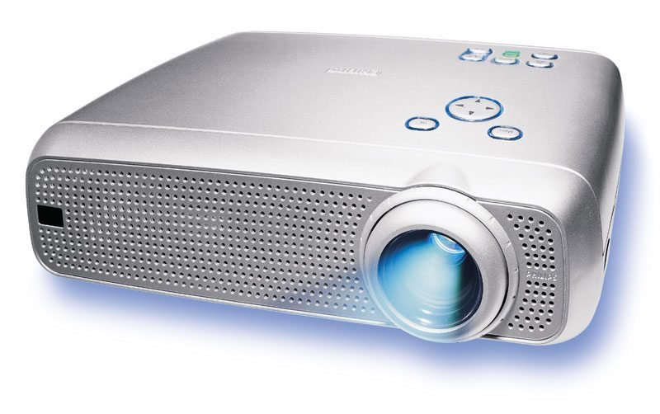
Visual Output devices - Projectors
Projects output from computer onto another medium
Useful for where output is required for a group rather than an individual
Wide range in quality. High end projectors can cost up to €10,000
Visual Output Devices

Slide 55
Visual Output devices - Printers
Popular printing technology builds up characters on page, as on the screen, as a series of dots - colour or monochrome in these categories:
Dot-matrix printers
Inkjet printers
Thermal printers or fax machines
Laser printers
Photographic printers
Visual Output Devices

Slide 56
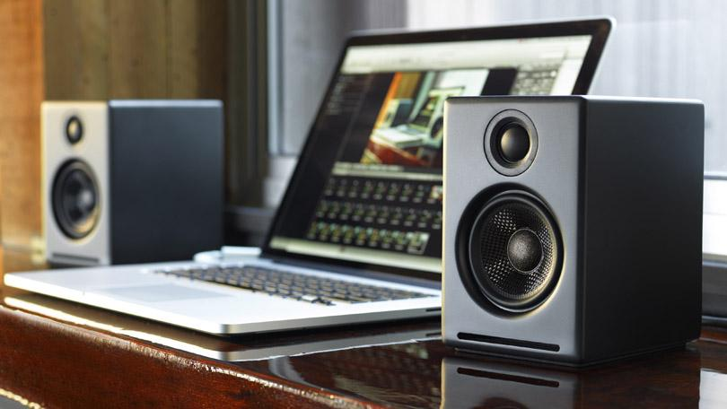
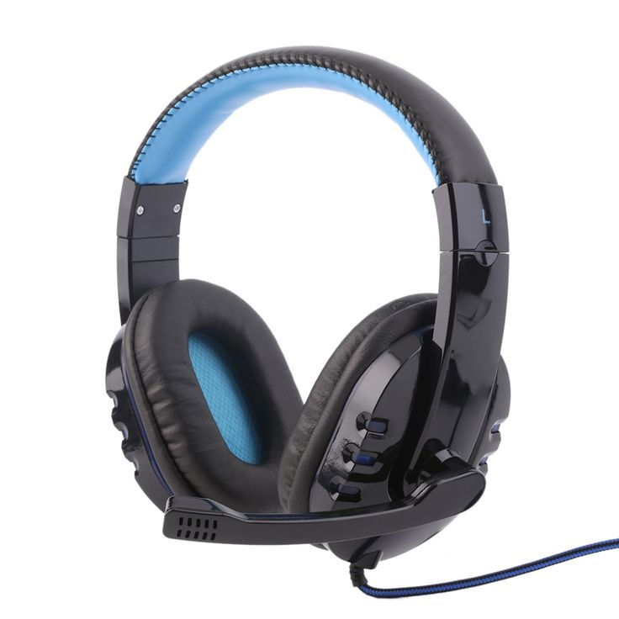
sound Output devices
Speakers
Various types of speakers e.g. Common coil and cone, Electro static, Direct digital speaker
Headphones
Visual Output Devices

Slide 57
In what situations does sound need to be output?
Where sound complements a visual interface
For alerting and feedback purposes are required
Where eyes are engaged on another task
Where background processes need to be monitored (e.g. disk access noise when saving a file)
Applications for blind or partially sighted users
Applications for illiterate users
Applications for users with limited mobility
Visual Output Devices

Slide 58
Reminder – Selecting Input and output Devices
Need to consider:
The User’s physiological capabilities
The User’s expertise
Appropriateness for tasks
Work and environment
Visual Output Devices

Slide 59
Selecting Input Devices
Match the user’s physiological capabilities
E.G. keyboard for older users with arthritis may be a problem
Match the user’s expertise
E.G. keyboard for older users or inexperienced users may be a problem
Should be appropriate for the tasks performed
E.G. for drawing, need a device that allows continuous movement
Should be suitable for the intended work and environment
E.G.. speech input not suitable for noisy conditions
Visual Output Devices

Slide 60
Selecting Output Devices
Match the user’s physiological capabilities
E.G Screens for visual output may be a problem for users with visual disabilities
Match the user’s expertise
E.G Touch screen for users with physical disabilities may be a problem
Should be appropriate for the tasks performed
E.G. For graphics, you may need a monitor with high definition, or a printer with many dots-per-inch (DPI)
Should be suitable for the intended work and environment
E.G. sound output not suitable for noisy conditions
Visual Output Devices

Slide 61
Summary of the Lecture
Input Devices
Text entry devices
Keyboards – QWERTY, Alphabetic, Chord, Dvorak, Braille
Handwriting Recognition
Speech Recognition
Positioning and pointing devices
Direct control devices
Indirect control devices
Keystroke Level Model
Devices for disabled
Output Devices
Visual output
Sound output

Slide 62
References
Shneiderman, B. & Plaisant, C. (2005) Designing the User Interface
Preece, J. et al. (2002) Interaction Design
Benyon, D. et al (2005) Designing Interactive Systems
Helander, M. et al (1997) Handbook of Human-Computer Interaction
Norman, D. (1990) The Design of Everyday Things
References

